Slide 1
SALARY ESTIMATION
BY:
PITCHUKA NAGA SHAIMIKA(2110030039)
D. BHANU PRAKASH(2110030298)
B. VARUN KUMAR(2110030321)
SRI VATHSAVA(2110030337)
NISHIKANT(2110039483)
UNDER THE GUIDANCE OF:
MRS. FIGLU MOHANTY.

Slide 2
Problem Statement:
The purpose of this project is to use data transformation and machine learning to create a model that will predict a salary when given years of experience, job type, college degree, college major, industry, and miles from a metropolis.

Slide 3
Literature Survey:
In research [8] by Rajveer Singh conducted a study for salary estimation for entry-level Indian engineering graduates indicates that the academic performance in school and college, school affiliation, college reputation are important indicators for starting salary. C.-C. Hung, E.-P. Lim [9] in their paper proposed “Company, Occupation, Company” (COC) model to derive unbiased salaries by aggregating job review and job post data. This model can predict unbiased salaries, companies’ inflation, and competitiveness effectively.

Slide 4
The objective is to narrow down on the best algorithms that suit both the data and the business requirements. High performance can be short-lived if the chosen model is tightly coupled with the training data and fails to interpret unseen data.
So, it’s also important to find the model that under- stands underlying data patterns so that the predictions are long-lasting and the need for re-training is minimal.
Each model or any machine learning algorithm.
It has several features that process the data in different ways. The challenge is to understand which parameters, data, and me- tadata must be considered to arrive at the final choice.

Slide 5
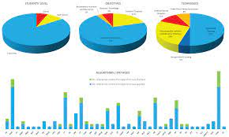
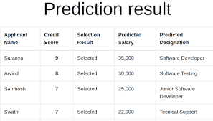

Slide 6
Dataset:
The data for this model is fairly simplified as it has very few missing areas. The raw data consists of a training dataset with the features – job Type, degree, major, industry, years Experience and miles from Metropolis and their corresponding salaries. Twenty percent of this training dataset was split into a test dataset with corresponding salaries.
There is also a testing dataset that does not have any salary information available and was used as a substitute for real-world data and used the model to predict it's values/salaries.

Slide 7
Requirements:
Import warnings.
Import pandas as pd.
Import re
Matplotlib
Warnings.filterwarnings
Import seaborn as sns

Slide 8
Information Used to Predict Salaries:
Years Experience: How many years of experience
Job Type: The position held (CEO, CFO, CTO, Vice President, Manager, Janitor, and senior or junior position)
College Degree: Doctoral, Masters, Bachelors, High School, or None
College Major: Biology, Business, Chemistry, Computer Science, Engineering, Literature, Math, Physics, or None
Industry: Auto, Education, Finance, Health, Oil, Service, or Web
Miles From Metropolis: How many miles away from a major city

Slide 9
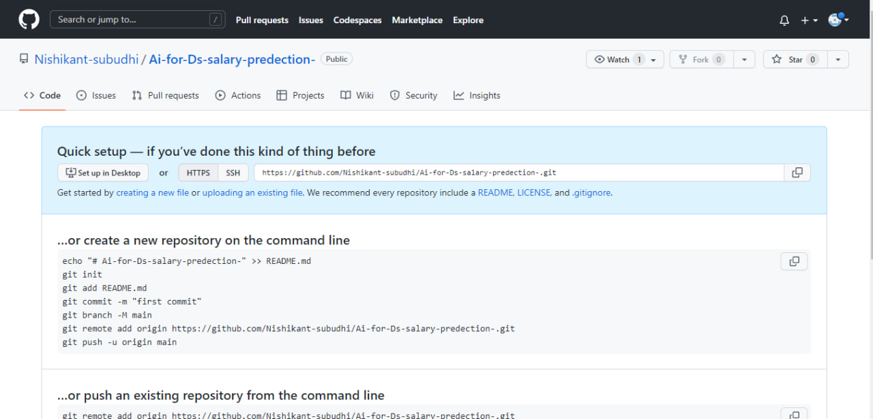
Github Setup:
https://github.com/Nishikant-subudhi/Ai-for-Ds-salary-predection-

Slide 10
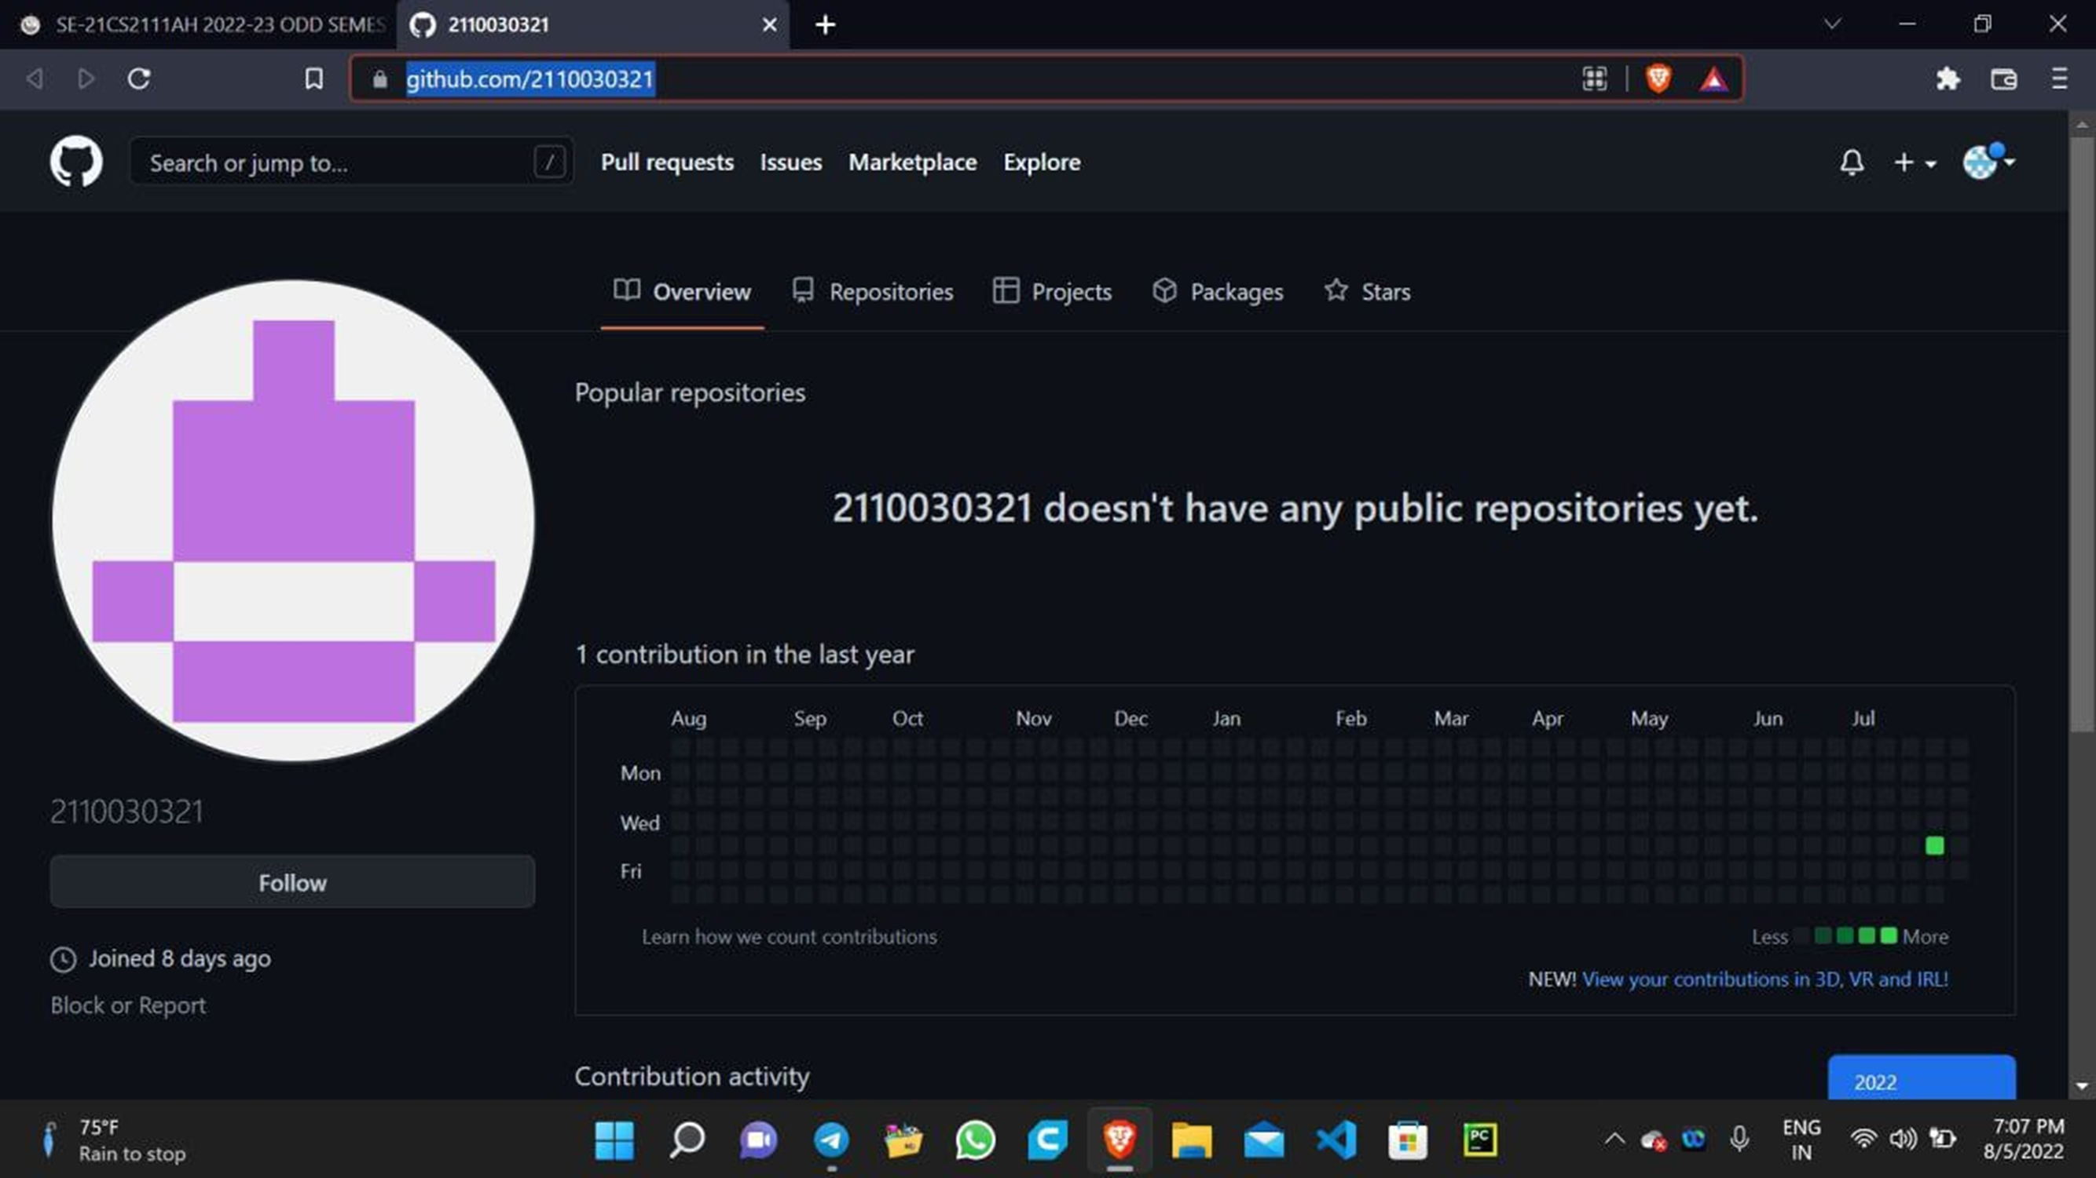
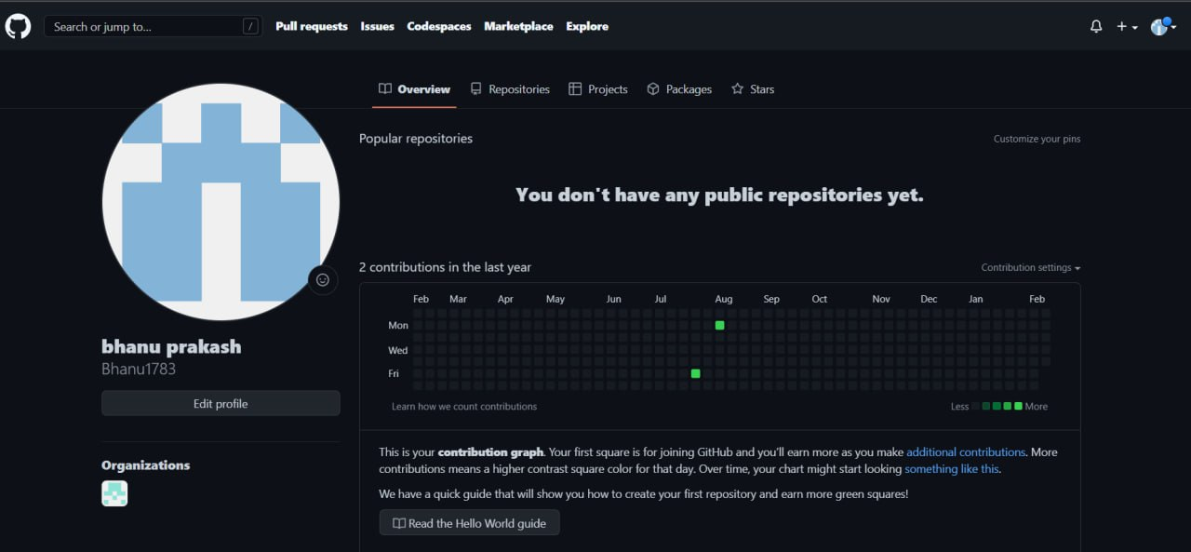
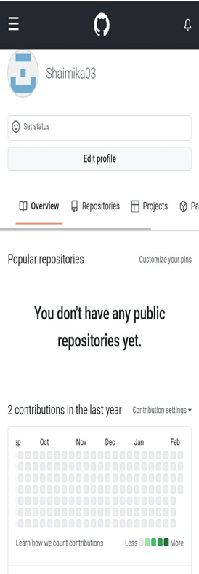
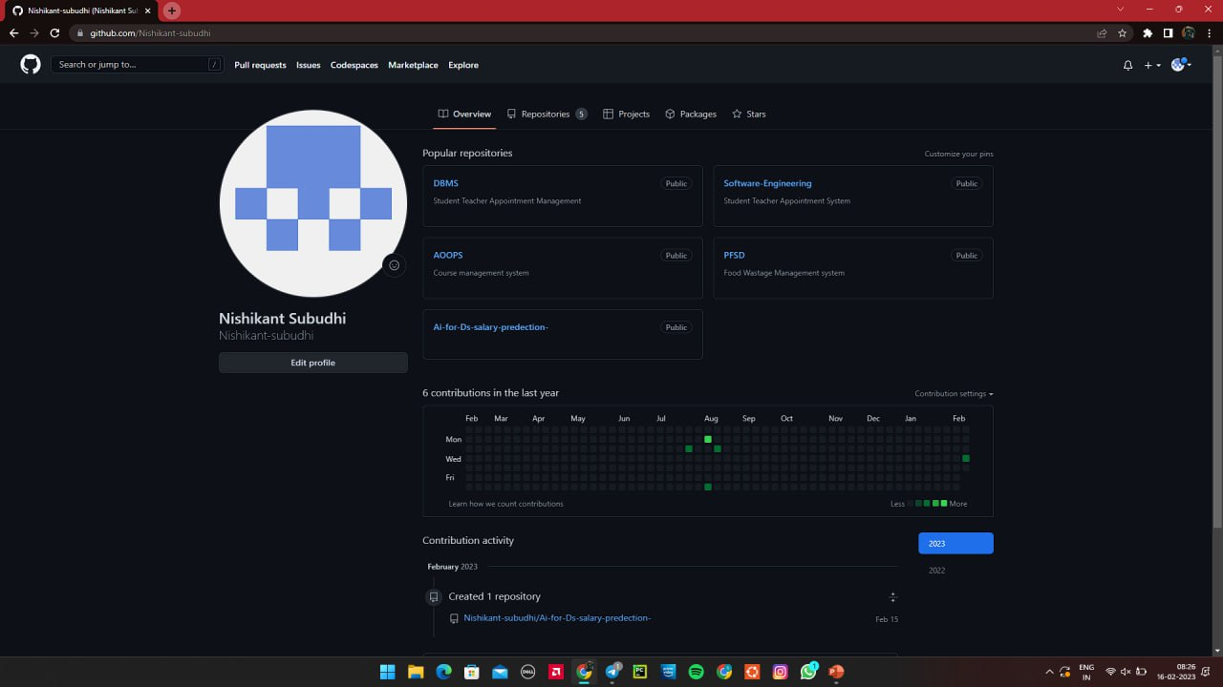
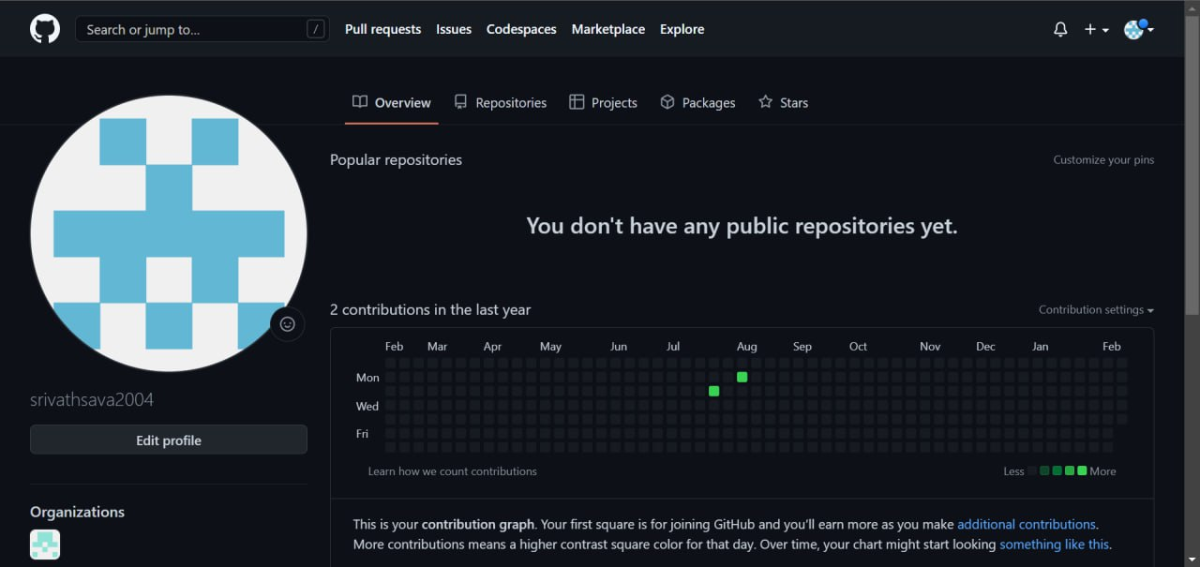

Slide 11
Thank You

